Slide 1
Grief

Slide 2
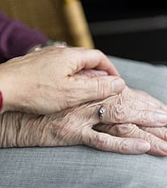
Everyone processes grief in their own way, so be patient with others...and yourself.

Slide 3
It is not unusual to have a range of emotions
Denial
Anger
Depression
Anxiety
Isolation
Confusion
Acceptance

Slide 4
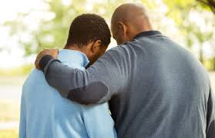
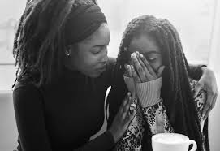
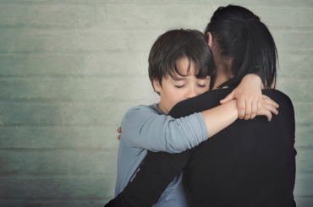
Tell someone how you feel.

Slide 5
Don’t forget to listen.
They may be grieving too.

Slide 6
Many people also find comfort in their faith.

Slide 7
If you don’t feel like talking with anyone right now, that is normal. Please know there is a lot of information on the web about grief, its stages and healthy coping skills. You are not alone. We all experience loss many times throughout our lives, and we all learn how to recover...step by step.

Slide 8
The staff at Franklin Central cares about you. If you want to talk with someone, you can reach out to your counselor, teachers, dean, support staff, administrators, coaches, and club sponsors.

Slide 9
It’s OK to
be OK.
Thanks, Josh T.

